Slide 1
SDLC Final Project
Chris McLernon
CS-250

Slide 2
AGILE VS WATERFALL
Adaptability: Agile is highly adaptable, allowing teams to respond to changing requirements and priorities throughout the project.
Customer-Centric: Agile puts a strong emphasis on customer collaboration, ensuring that the product aligns with the customer's evolving needs and preferences.
Continuous Delivery: Agile promotes the regular delivery of working software, which allows for early and frequent releases of valuable features.
Cross-Functional Teams: Agile teams consist of diverse skill sets, fostering collaboration and collective ownership of project tasks.
Reduced Risk: Agile has an iterative approach that reduces the risk of delivering a final product that doesn't meet customer expectations, as feedback is continually integrated into the development process.
Clear Project Scope: Waterfall is effective for projects with well-defined and stable requirements, where changes are expected to be minimal.
Structured and Predictable: The sequential nature of Waterfall provides a structured and predictable
framework, making it easier to plan and manage projects.
Thorough Documentation: Waterfall emphasizes extensive documentation at each stage, ensuring a detailed record of project activities and decisions.
Phased Approach: Each phase must be completed before moving on to the next, which can help in ensuring a methodical and comprehensive development process.
Quality Control: With testing conducted after development, Waterfall allows for a focused and thorough evaluation of the product's quality.

Slide 3
Defining the Member’s on the Team
Product Owner: Defines and prioritizes what needs to be built, representing the customer's interests, setting the product vision, and ensuring the team delivers value to the customer.
Scrum Master: Facilitates the Scrum process, coaches the team, and removes obstacles to support a collaborative and self-organizing work environment.
Developer: Works as a cross-functional team to design, develop, and test the software, following the product backlog requirements and collaborating with the Product Owner.
Tester: Focus on quality assurance and testing, verifying that the software meets requirements, executing test cases, and collaborating with developers to resolve issues.

Slide 4
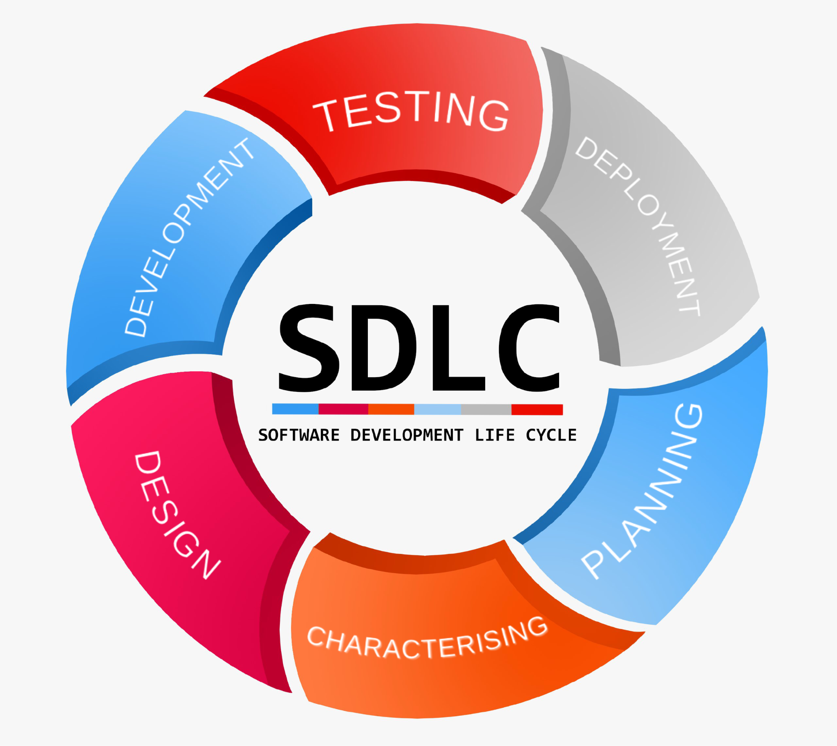
Planning:
Short-term goals
Flexibility
Customer-centric
Analysis and Requirements:
Continuous refinement
Detailed just in time
Design:
Collaborative and evolving
Incremental design
Development:
Rapid delivery
Frequent feedback
Testing:
Concurrent with development
High-quality product
Deployment:
Frequent, incremental releases
Maintenance and Feedback:
Ongoing evolution
Customer-driven improvements

Slide 5
Comparing Approaches
Waterfall Approach:
Change treated as a formal request.
Extensive documentation and approval process.
Formal revisions to the entire project plan.
Longer timelines and added costs.
Agile Approach:
Identification and Adaptation within ongoing sprints.
Immediate feedback and collaboration with the customer.
Continuous improvement to meet changing needs.
Key Differences:
Agile embraces change and is flexible.
Waterfall follows a rigid and formal change process.
Agile maintains continuous customer collaboration.
Waterfall has limited customer involvement post-initial requirements.

